Slide 1
Welcome to 4th Grade Curriculum Night
Please sign in next to your child's name at the front table.

Slide 2
Agenda
Communication
Cultures of Thinking/Growth Mindset/ 7 Habits
Class Procedures
Curriculum
Assessment
Standards Based Grading
Behavior Expectations
Food
Parent Involvement
Bond Information
Questions

Slide 3
Communication
E-Mail:
Kristen.Malkasian@lok12.org
David.Stafford@lok12.org
Allison.Webb@lok12.org
Phone: 248-693-5460
Class Website on Blanche Sims page (updated every Friday)
http://fourthgradesims.weebly.com/
Twitter
Malkasian- @mrsmalkasian Stafford- @MrStaffordLO Webb- @MrsWebb18

Slide 4
A Culture of Thinking: Why is it Important?
Real, deep, and lasting learning is a product of thinking. Students’ thinking needs ongoing support & encouragement.
Habits of mind and dispositions toward thinking and understanding cannot be taught, they must be enculturated over time.
Learning is a social endeavor and unfolds within that context.
Instructional methods and curriculum aren’t enough to develop understanding. It needs the ongoing support of the environment.

Slide 5
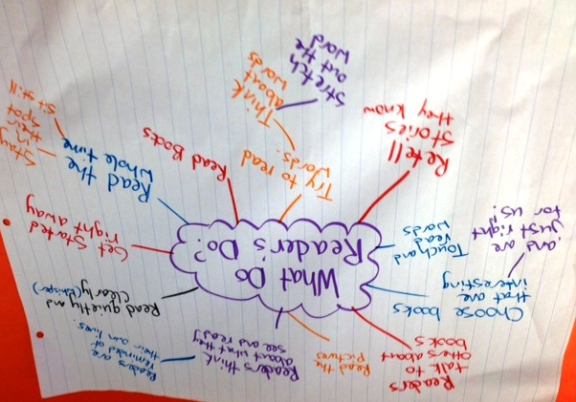
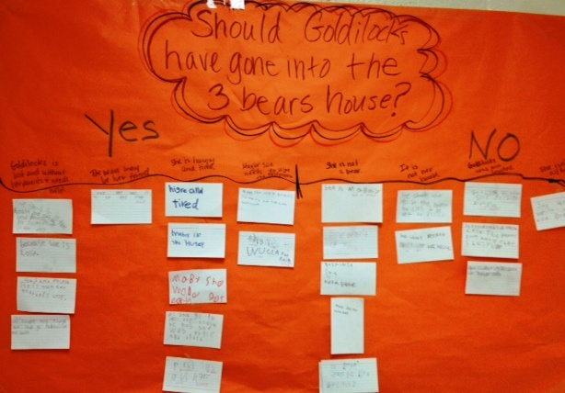
Cultures of Thinking ...
Are places in which a group’s collective, as well as individual, thinking is valued, visible, and actively promoted as part of the regular, day-to-day experience of all group members.

Slide 6
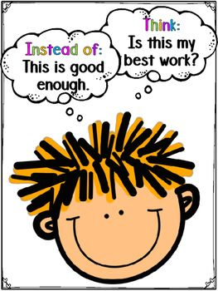
Growth Mindset
A growth mindset can greatly improve a child's academic performance and motivation to learn.
We will be teaching and reviewing the five stances: Empathy, Flexibility, Resilience, Persistence, and Optimism
You can help by changing how you phrase your feedback.
I see that you have been trying so hard at...
I like the way that you...
Good job taking on such a hard task...

Slide 7
7 Habits
Be proactive
Begin with the end in mind
Put first things first
Think win-win
Seek first to understand, then to be understood
Synergize
Sharpen the saw

Slide 8
Data Binders
With the 7 Habits in mind, students will be adding to their individual data binders throughout the year.
Focus on personal and academic goals
Monitor growth over time
Reflections on how we can improve

Slide 9
Class Procedures
Classwork
Expectation is that all work will be done in class
Quality work
Students keep work on clipboard or in folder
Individual or group work
Homework
Read every night for 20 minutes
Study math facts
Word Study will be written in planner

Slide 10
Language Arts
Reading Workshop:
Students read at their independent level and are taught how to choose books.
Teacher confers with students to meet needs.
Word Study: Words their Way with a focus on study of words and their patterns.
Students are grouped into developmental levels based on word study inventories. Not all students will have the same words.
Students are introduced to a new group of words with a specific feature focus.
Students sort words, complete word hunts, play games, and keep a word study notebook.
Students assessed using various measures not just weekly spelling tests.

Slide 11
Language Arts
Writing Workshop (Lucy Calkins)
Connection, teaching, active engagement, link, practice, and share
Daily
Aligned to the Common Core
Writing in different genres
Realistic Fiction
Literary Essays
Opinion Essays
Informational

Slide 12
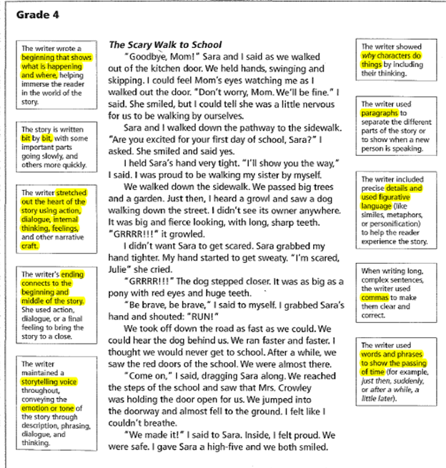
Expectation for Narrative Writing

Slide 13
Math
Place value and multi-digit addition and subtraction
Multiplication and division of whole numbers
Fractions and decimals
Measurement
Geometry
Equations and word problems
Math Talk
Learning Targets/Success Criteria
Mastery of basic facts
Think Central, Prodigy, Khan Academy

Slide 14
Science and Social Studies
Science
Phenomenal Science
Engineering Process Pathway
Units: Energy, Waves and Information Transfer, Earth Systems
Social Studies
U.S. regions and government
Mapping skills
Economic concepts

Slide 15
Assessments
Reading: anecdotal notes, observation, comprehension work, response to reading, and TC
Writing: progressive rubric
Math: pre and post testing, some daily work, quick quizzes, and common assessments
Science/S.S.: end of unit tests, projects, class work
Word Study: word sorts, tests, activities
All assessments receive a 1, 2, 3, or 4.
4 is end of the year expectation

Slide 16
Standards Based Grading
Standards Based Grading works in a way that provides a learning continuum. As teachers plan for lessons, they use units of study that align to these standards and determine what assignments and assessments students will do along the way.
Once completed, teachers then look at those assignments and assessments and determine student progress toward the standards.
The descriptions of the 1, 2, 3, 4 level work for final grading purposes can be found in the grade book reporting criteria for each content area. It is through the grade book reporting criteria that we support common expectations for student performance across our entire district.
Report cards are given two times per year. January and June
Parent conferences are two times per year. November and March. Parents attend both conferences. A sign-up genius will be used to schedule conferences.

Slide 17
Behavior Expectations
We have spent time discussing our rules and the children know that they are responsible for their actions. I will encourage them to make good choices every day and help others as well.
What is the heart of it?
Students knowing specifically what to do.
Students are self-monitoring themselves.
Classroom teachers at the forefront of the behavior intervention system (through lessons and class meetings)
What does it include?
Behavior lessons
Class meeting structure
Kind Reminder process for problem solving
The 4 Steps process when learning is interrupted
A system to reteach behaviors to students who need it

Slide 18
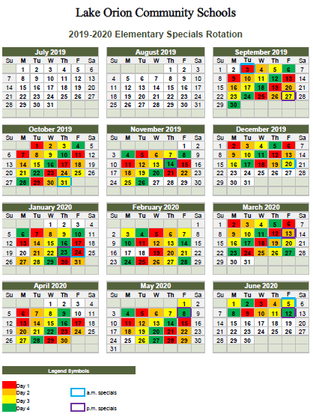
Specials Rotation

Slide 19
Food
Peanut Aware School
Breakfast is an option before school. (8:30)
Lunch: 11:50-12:38
Cost: $2.90
No longer accept checks
Snack: daily, nutritious please- No peanuts or tree nuts in the classroom
Elementary classroom-provided birthday celebrations prefer non-edible items and/or activities. If an edible treat is provided, it must be pre-packaged and store purchased with ingredient list. Edible treat will be sent home rather than eaten in the classroom.

Slide 20
Parent Involvement
Daily at home: check planner, nightly reading and homework
Volunteers: please make arrangements with me. Some prefer working with kids and others prefer “paper” work.
If volunteers are working one on one with students in isolation (mentoring, one on one, hallway, testing) they will need to be fingerprinted at the volunteer's expense.
Parties/Celebrations: We will need volunteers to help organize and run celebrations for Halloween, the Holidays, and Valentine's day.
P.T.O.: a fantastic organization that supports our school.

Slide 21
Bond Information
https://www.lakeorionschools.org/bond

Slide 22
Questions?
Thank you for coming!

